Slide 1
Tips for a more efficient SAS program (and occasionally cleaner code)
Presented by Matthew Shotts
At the January 12th, 2017 Skills Sharing meeting

Slide 2
Efficiency gains are proportional to your data
The considerations in this presentation will yield more savings as the number of records and variables increases.
Even if you don’t typically work with millions of records, using these techniques can yield time savings during the execution of the program and cumulatively over time as the program is re-used.

Slide 3
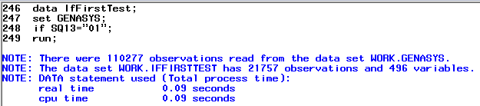
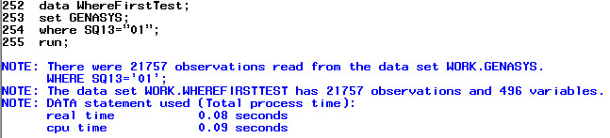
Subsetting if vs where – temp SAS dataset
The removal of records that don’t meet the ‘if’ statement occurs after all records have been read in.
With ‘where’, the removal of the records is taking place as the dataset is being populated and is more efficient.

Slide 4
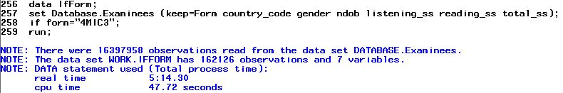
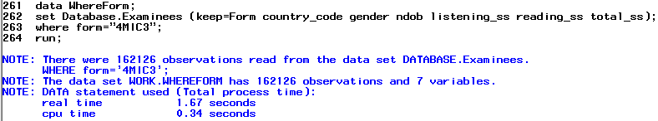
Subsetting if vs where – indexed SQL server
The efficiency of ‘where’ is even more obvious in certain contexts.
Data subsetted with ‘if’ took over 5 minutes.
A comparable ‘where’ took less than 2 seconds to process in this context of an indexed SQL server.

Slide 5
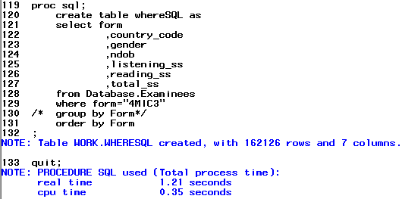
Data step vs proc SQL – indexed SQL server
Data step and proc sql were both fast (1.67 vs 1.21 seconds) but the real gains with proc sql come from the many functions it can perform within one proc (see James Carroll ‘Proc SQL Just the Basics’ presentation for examples).

Slide 6
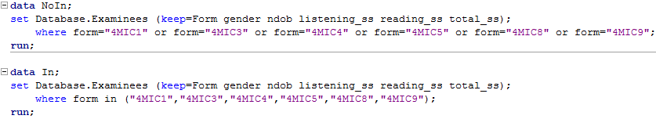
The use of ‘in’ and ‘not in’ when subsetting
‘in’ or ‘not in’ can be used in place of a series of ‘or’ statements when subsetting data. The two examples below will yield the same records but the example with ‘in’ is easier to follow and requires less keystrokes to code. No differences in performance were noted between the two.
‘in’ and ‘not in’ are not limited to the ‘where’ statement and can also be used with ‘if’.

Slide 7
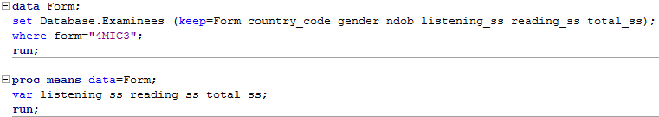

Unnecessary data steps
Use a ‘where’ in procs rather than creating a supporting dataset unless that dataset is needed elsewhere in the program.
Less efficient
More efficient

Slide 8
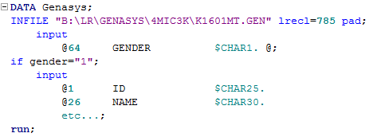
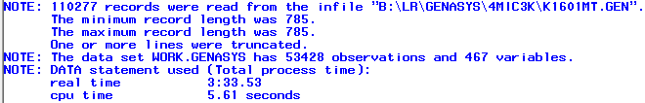
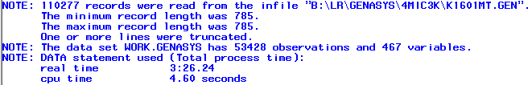
Use of subsetting if during input of flat file
Subsetting if used after input is complete
Subsetting if used within the input

Slide 9
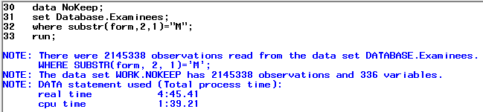
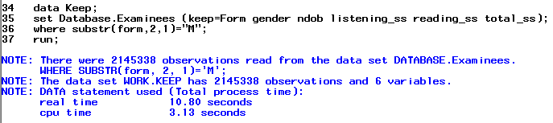
Keep only what you need
This data step brought all 336 variables from its source and clocked in at 4 minutes and 45 seconds.
This data step only kept the 6 variables of interest and clocked in at 10 seconds.
The placement of the keep statement also matters. If ‘keep’ had been placed at the ‘data’ line rather than the ‘set’ line then all of the records from the database would still have been read in and processing time would have been similar to the ‘NoKeep’ example.

Slide 10
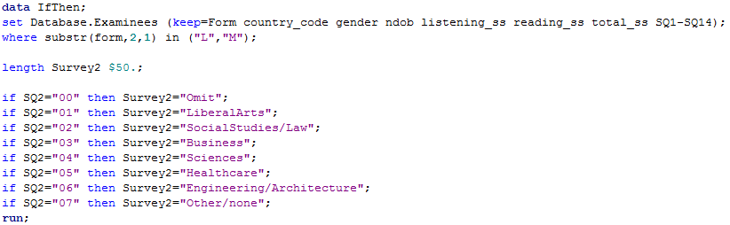
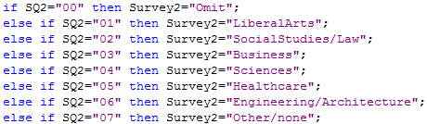
‘if-then’ vs ‘if-then-else’
Using ‘if-then’ with ‘else’ excludes any records that previously met the condition when resolving the next ‘if’. With a dataset of close to 5 million records, ‘if-then-else’ was faster by close to 5 seconds (44.28 vs 49.90). These gains can be maximized by ordering the if-then-else statements by expected probability.

Slide 11
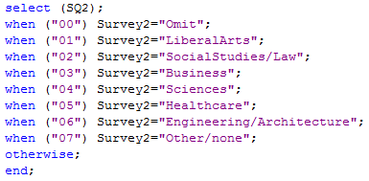
Select-when instead of if-then-else
Select-when implicitly makes the same assumption as if-then-else in that it doesn’t re-evaluate records that have already met the criteria. Processing times were similar to if-then-else but has the advantage of being more compact code, however, it’s application is more limited since multiple variables can’t be used in the select.

Slide 12
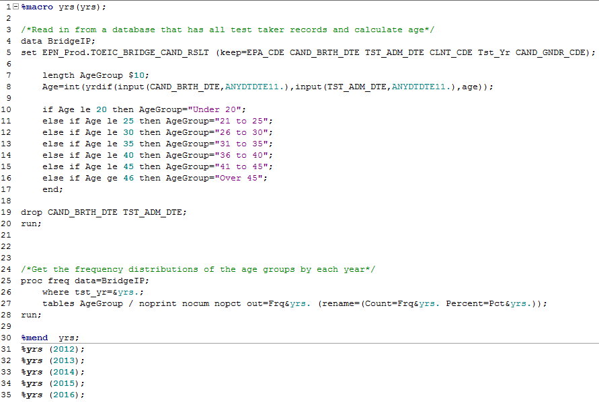
Effective Macro Placement
Take care to place macros only around those steps that need to be repeated.

Slide 13
Questions for thought when reviewing a program for efficiency
Is this dataset needed?
Can a proc get this information from an earlier dataset using ‘where’?
Does this data step perform any unique operations that could not be taken earlier in the code? If not, those operations could be moved to the earlier data step and this data step dropped assuming similar dataset volumes.
Use data _null_; in data steps that are used to export a file.
Are these variables needed for the actions being performed in this or later data steps? If not, then consider not keeping them.
Are there proc sorts that can be avoided either through the use of proc sql or other techniques such as defining class in proc means?
Do the macros include any steps that only need to take place once?

Slide 14
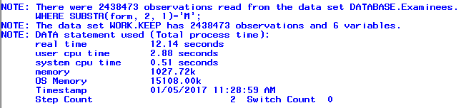
Obtaining more detailed performance info
The SAS option ‘fullstimer’ will give you more information about time used as well as the resources needed to complete the operation.
The option can be turned off with ‘nofullstimer’.

